Slide 1
Analysis of A non-LINEAR VIBRATION CONTROL SYSTEM
Presented by:
Aamir Haider 234103402

Slide 2
INTRODUCTION
The purpose of the vibration control system is to absorb the resonant portions of the whole wave frequencies band, increasing the overall safety.
The vibration control system modeled considered here consists of quasi-zero stiffness system and nonlinear energy.
In the project we study the nature of the system’s response, for a given input and initial conditions, and check the steady state response.
The steady state response is found using the harmonic balance method and frequency ratio for which there is large change in response amplitude is found.

Slide 3
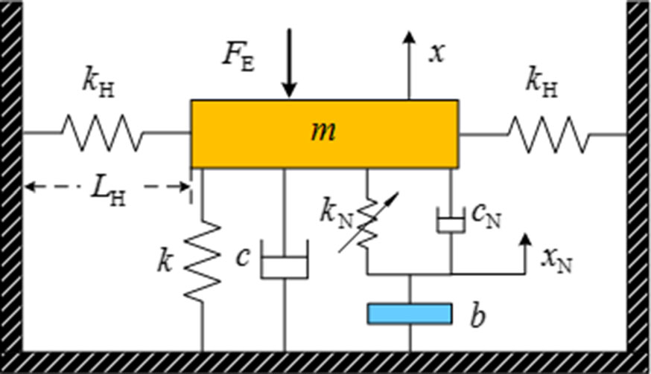
MECHANICAL MODEL
Figure 1 shows the mechanical model
of the system with quasi-zero stiffness
and non-linear energy sink.
Representative vibration isolation
design with strong nonlinear stiffness
Proper design parameters can lead to
ultra-low stiffness making it a great passive isolation device.
Low stiffness results in weakening of the total linear stiffness of the system.
Weak resistance to deformation resulting in large resonance deformation.
Figure : 1

Slide 4
MECHANICAL MODEL (contd.)
Due to introduction of strong nonlinearity, steady state response of the system present strong nonlinear characteristics, which affect the vibration isolation bandwidth.
To suppress the above shortcoming, a nonlinear energy sink is introduced.
Vibration dissipating device composed of the nonlinear elastic element, inertance element and a dissipating element.
As a dissipating device prevents energy accumulation due to low stiffness of the system.
Reducing the risk of instability or damage to the system.

Slide 5
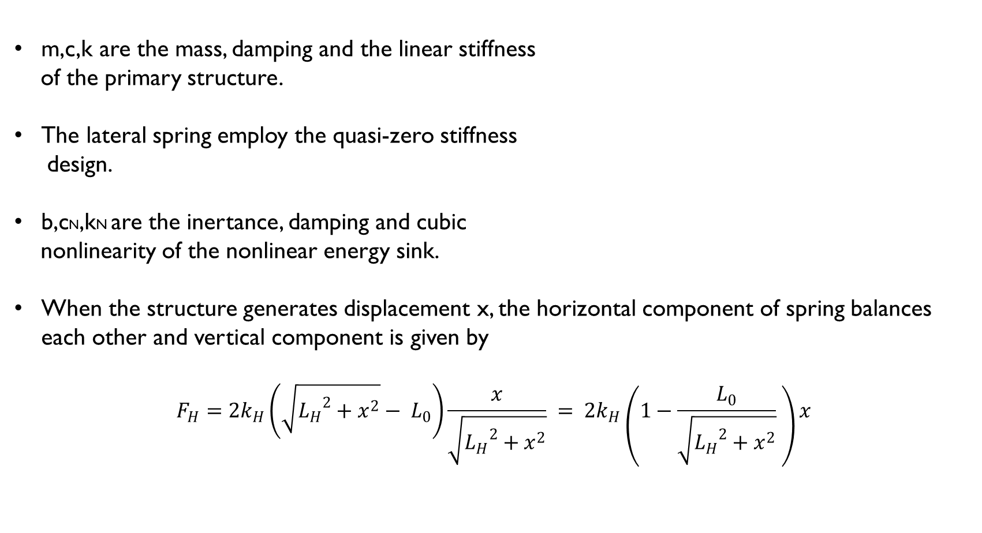
MATHEMATICAL MODEL
m,c,k are the mass, damping and the linear stiffness
of the primary structure.
The lateral spring employ the quasi-zero stiffness
design.
b,cN,kN are the inertance, damping and cubic
nonlinearity of the nonlinear energy sink.
When the structure generates displacement x, the horizontal component of spring balances each other and vertical component is given by
$$F_{H}=2k_{H}\left(\sqrt{{L_{H}}^{2}+x^{2}}− L_{0}\right)\frac{x}{\sqrt{{L_{H}}^{2}+x^{2}}} = 2k_{H}\left(1−\frac{L_{0}}{\sqrt{{L_{H}}^{2}+x^{2}}} \right)x$$

Slide 6

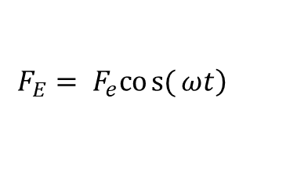
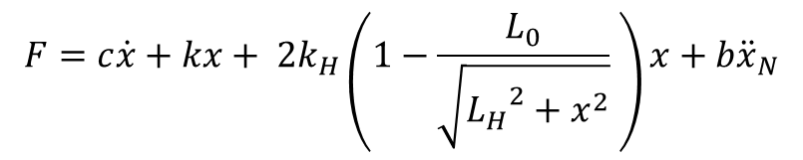
MATHEMATICAL MODEL (contd)
By using Newton’s second law, the equation of motion is given by
$$m\ddot{x}+c\dot{x}+kx+2\left(1−\frac{L_{O}}{L_{H}}\right)k_{H}x+ \frac{L_{O}}{L_{H}^{3}}k_{H}x^{3}+c_{N}\left(\dot{x}−\dot{x_{N}}\right)+k_{N}{\left(\dot{x}−\dot{x_{N}}\right)}^{3}+F_{e}\cos\left(ωt\right)=0$$
$$b\ddot{x_{N}}+ c_{N}\left(\dot{{\dot{x}}_{N}−\dot{x}}\right)+k_{N}{\left(x−x_{N}\right)}^{3}=0$$
The resultant force between the system and foundation in the vertical direction is given by
$$F=c\dot{x}+kx+ 2k_{H}\left(1−\frac{L_{0}}{\sqrt{{L_{H}}^{2}+x^{2}}} \right)x+b{\ddot{x}}_{N}$$
The external excitation force on the system is given by
$$\left.F_{E}= F_{e}cos{(}ωt\right)$$

Slide 7

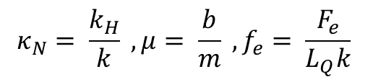
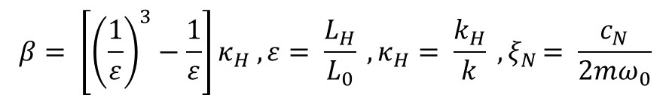
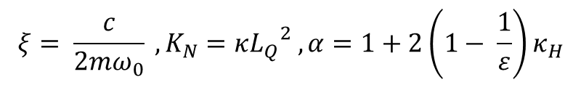
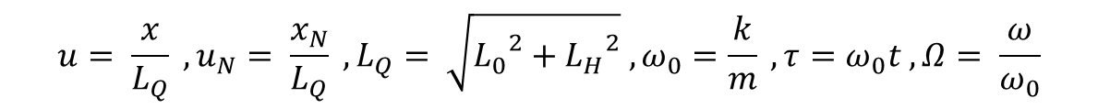
MATHEMATICAL MODEL (contd)
The equation of motion in the dimensionless form
$$\ddot{u}+2ξ\dot{u}+αu+ βu^{3}+2ξ_{N}\left(\dot{u}−\dot{u_{N}}\right)+K_{N}{\left(u−u_{N}\right)}^{3}+f_{e}\cos\left(Ωt\right)=0$$
$$μ\ddot{u_{N}}+ 2ξ_{N}\left(\dot{u_{N}−\dot{u}}\right)+K_{N}{\left(u_{N}−u\right)}^{3}=0$$
$$u= \frac{x}{L_{Q}} , u_{N}= \frac{x_{N}}{L_{Q}} , L_{Q}= \sqrt{{L_{0}}^{2}+{L_{H}}^{2}} , ω_{0}=\frac{k}{m} , τ=ω_{0}t , Ω= \frac{ω}{ω_{0}}$$
$$ξ= \frac{c}{2mω_{0}} , K_{N}={{κL}_{Q}}^{2} , α=1+2\left(1− \frac{1}{ε}\right)κ_{H}$$
$$β= \left[{\left(\frac{1}{ε}\right)}^{3}−\frac{1}{ε}\right]κ_{H} , ε= \frac{L_{H}}{L_{0}} , κ_{H}= \frac{k_{H}}{k} {, ξ}_{N}= \frac{c_{N}}{2mω_{0}}$$
$$κ_{N}= \frac{k_{H}}{k} , μ= \frac{b}{m} , f_{e}= \frac{F_{e}}{L_{Q}k}$$

Slide 8
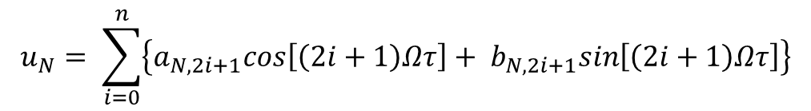
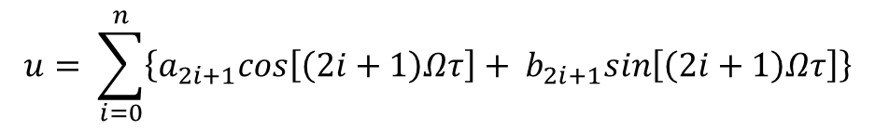


STEADY STATE RESPONSE
The steady state response of the system is found using the harmonic balance method
$$u= \sum_{i=0}^{n}{\left\{a_{2i+1}cos\left[\left(2i+1\right)Ωτ\right]+ b_{2i+1}sin\left[\left(2i+1\right)Ωτ\right]\right\}}$$
$$u_{N}= \sum_{i=0}^{n}{\left\{a_{N,2i+1}cos\left[\left(2i+1\right)Ωτ\right]+ b_{N,2i+1}sin\left[\left(2i+1\right)Ωτ\right]\right\}}$$
Taking first order harmonic the above equations reduce to
$$u=a_{1}\cos\left(Ωτ\right)+b_{1}\sin\left(Ωτ\right)$$
$$u_{N}=a_{N,1}\cos\left(Ωτ\right)+b_{N,1}\sin\left(Ωτ\right)$$

Slide 9
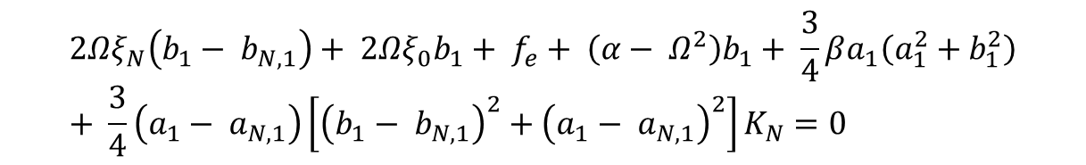
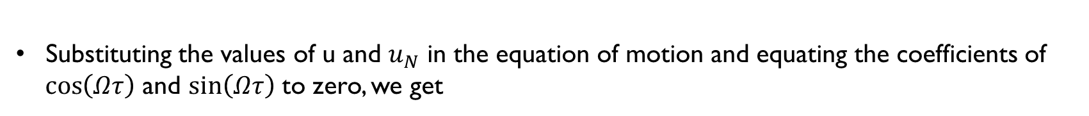
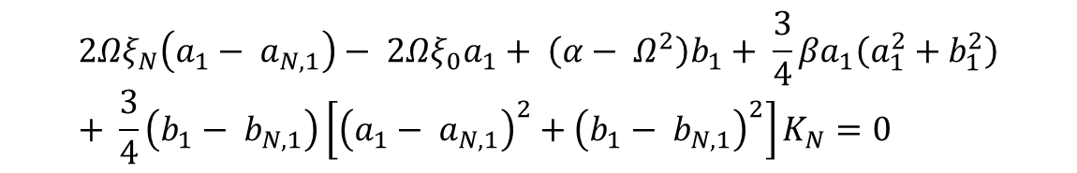
STEADY STATE RESPONSE
Substituting the values of u and $u_{N}$ in the equation of motion and equating the coefficients of
$\cos\left(Ωτ\right)$ and $\sin\left(Ωτ\right)$ to zero, we get
$$2Ωξ_{N}\left(b_{1}− b_{N,1}\right)+ 2Ωξ_{0}b_{1}+ f_{e}+ \left(α− Ω^{2}\right)b_{1}+ \frac{3}{4}βa_{1}\left(a_{1}^{2}+b_{1}^{2}\right)+ \frac{3}{4}\left(a_{1}− a_{N,1}\right)\left[{\left(b_{1}− b_{N,1}\right)}^{2}+{\left(a_{1}− a_{N,1}\right)}^{2}\right]K_{N}=0$$
$$2Ωξ_{N}\left(a_{1}− a_{N,1}\right)− 2Ωξ_{0}a_{1}+ \left(α− Ω^{2}\right)b_{1}+ \frac{3}{4}βa_{1}\left(a_{1}^{2}+b_{1}^{2}\right)+ \frac{3}{4}\left(b_{1}− b_{N,1}\right)\left[{\left(a_{1}− a_{N,1}\right)}^{2}+{\left(b_{1}− b_{N,1}\right)}^{2}\right]K_{N}=0$$
$$−μΩ^{2}a_{N,1}− 2Ωξ_{N}\left(b_{1}− b_{N,1}\right)− \frac{3}{4}\left(a_{1}− a_{N,1}\right)\left[{\left(a_{1}− a_{N,1}\right)}^{2}+{\left(b_{1}− b_{N,1}\right)}^{2}\right]K_{N}=0$$
$$−μΩ^{2}b_{N,1}+ 2Ωξ_{N}\left(b_{1}− b_{N,1}\right)− \frac{3}{4}\left(b_{1}− b_{N,1}\right)\left[{\left(a_{1}− a_{N,1}\right)}^{2}+{\left(b_{1}− b_{N,1}\right)}^{2}\right]K_{N}=0$$

Slide 10
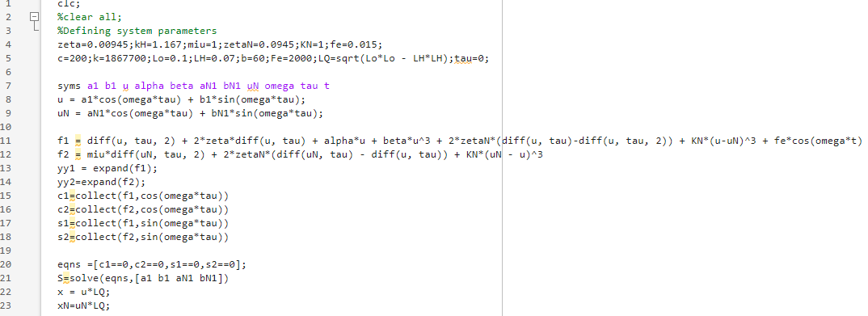
MATLAB CODE :

Slide 11
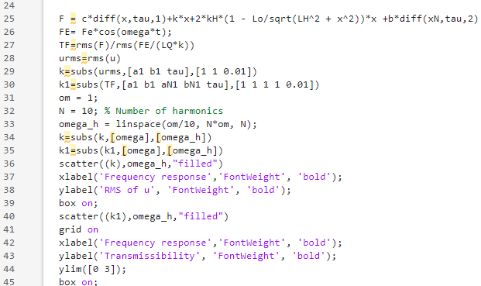
MATLAB CODE (Continued):

Slide 12
RESULTS :
As can be seen from the frequency response for (a) the displacement of primary structure (b) the force
transmissibility of the system, the curve shows significant nonlinear jumping phenomenon around the frequency
ratio of 0.3 and so for the given system parameters operating near frequency ratio of 0.3 should be avoided.

Slide 13
THANK YOU

